Slide 1


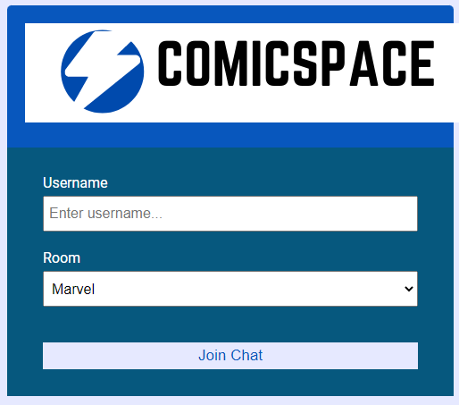
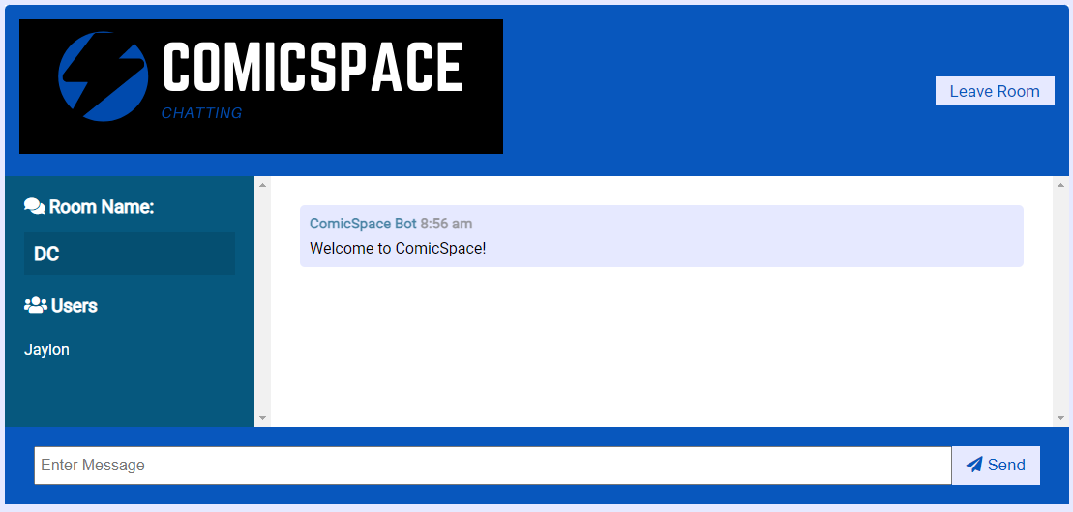
ComicSpace: A Chat Room For Comic Recommendations
Jaylon Kiper
Bellarmine University
ABSTRACT
MODULES
FUTURE
ComicSpace is a chat-based web application for comic fans to connect with each other on a social network.
This system allows users to compare comics, as well as giving recommending on the best runs and series.
This project involves coding and designing the user interface and a web scraper for the ComicSpace chat application.
The main web pages are designed using HTML, CSS, and JavaScript for both the login and chat rooms.
For the web scraper program, the main functionality involves a Python program using Beautiful Soup 4 libraries. The comics were scraped from the Midtown Comics website.
Messages.js
Formats the message by user and text typed
Main.js
Runs all front-end formatting
Users.js
Monitors users joining and leaving rooms
The purpose of this project is to create an application for comic fans to share their thoughts and ideas around comics. Eventually the comics that are recommend to be stored their account. Users would be able to track comics they have read or that they are interested in reading in the future. As a fan myself, I am proud to have built something based on what I enjoy the most.
Server.js
Runs the back-end of the website
Web Scraper.py
Package.json
REFERENCES
Alex. “Design a Chat System.” Systeminterview.com, 2016, systeminterview.com/design-a-chat-system.php.
Khambete, Kiran. “Web Based Chat Application.” Www.c-Sharpcorner.com, 15 June 2009, www.c-sharpcorner.com/article/web-based-chat-application/. Accessed 19 Jan. 2022.
Lawton, George. “AI Web Scraping Augments Data Collection.” SearchEnterpriseAI, 29 June 2020, www.techtarget.com/searchenterpriseai/feature/AI-web-scraping-augments-data-collection. Accessed 19 Jan. 2022.
Nava, Gabriel. “How to Create a Simple Web-Based Chat Application.” Code Envato Tuts+, 6 May 2021, code.tutsplus.com/tutorials/how-to-create-a-simple-web-based-chat-application--net-5931. Accessed 19 Jan. 2022.
OBJECTIVES
ComicSpace is designed for new comic readers and fans who wonder where to start or for fans who want more in-depth knowledge, including international titles.
USER INTERFACE
USE CASES
A user types their username into a login page.
Login opens the chat section where users interact with each other.
The system interface questions users about their preferences and scrapes web pages to list related comic series.
CONTACT
Phone: (502) 994-4349
Email: jkiper@bellarmine.edu
G-Mail: jaylonkiper13@gmail.com
Sponsor
Dr. Nathan P. Johnson
Department of Computer Science
Bellarmine University, 2022
Notes:
Since the start of this project, JavaScript was used as the structure of this project to create a chat application.
My progress on getting the user interface built for both the login page and the chat space for users to interact. My images and logos for them have also been added through Canvas.
Once all the message systems work for sending text across multiple users and their names appear on the screen, I created various JavaScript files to run the server, work the main pages and commit messages by the user and text. The separate rooms method now operates and for each user who is in that room to appear.
As the systems operated well with the users entering the rooms and the rooms do appear the way they should on the front-end. With the web scraper, this program pulls recommendations based on a user's preferences. My idea was to create a system in order to create suggestions for users based on what preferences they have. If someone is looking for any fantasy-based series, they get a specific set of comics, or if someone wants to read a mystery/detective style, then they would get another set.
Beautiful Soup, which is a Python library, is what pulls data out of HTML pages of a comic book database. It works with your HTML parser to provide idiomatic ways of navigating, searching, and modifying the parse tree. The objective is to learn how to use web scrapers based on chat users' results, then implement a copy system to add comic recommendations to users.
The result of this project has led to a functioning chat application. The server file links a path to the website and creates a server. Also, a bot formats a message whenever a user joins the room. This message welcomes the current user, broadcasts when a connection is made, whilst sending users and room information. There is also the function of listen for chat message and looking for when a user disconnects.
The main JavaScript file runs the entire site with how messages are produced and specifying which rooms a user is currently in. There are also message and users JavaScript files that work in tandem with the main file. With the index and chat HTML files, these display the overall layout of the web page with room selection and joining a chat depending on the room name. Both pages also include the various logos I have create with Canvas.
With the web-scraper built with Python, I was able to grab information based on titles form the Midtown Comics website. This is operated by the urlopen and Beautiful Soup libraries. This involves opening a connection and grabbing the page. The content from the page is then uploaded into a variable to an HTML parser. Then each product is grabbed and put into a container. Finally, the titles of all the comics are produced from a for loop.

